Slide 1
Understanding Epistemic and Aleatoric Errors
26 May 2022

Slide 2
Perfect Model
Look at epistemic & aleatoric variances with perfect features. Expect:
Epistemic variance to be small (for small regularization) compared to aleatoric variance
Aleatoric variance to be non-zero due to “unexplained variance” (lack of information content in the features)
Calculate model error by applying perfect model to perfect features
Residual here is the model error
Calculate likelihood of model error coming from aleatoric distribution with zero mean
Same for epistemic distribution with zero mean
Expect: high likelihood model error comes from zero-mean aleatoric distribution
Apply perfect model to noised up features
Residual now is sum model and propagated feature errors
Expect:
high likelihood residual comes from zero-mean aleatoric distributio
even lower likelihood residual comes from zero-mean epistemic distribution
aleatoric variance to increase, epistemic variance to remain unchanged compared to 2)

Slide 3
Imperfect Perfect Model
Train imperfect model and look at epistemic & aleatoric variances
Expect epistemic variance to increase compared to perfect model case
Apply imperfect model to noised up features
Residual now is sum model and propagated feature errors
Compute likelihood of residuals come from zero-mean epistemic and aleatoric distributions. Expect:
High likelihood residual comes from zero-mean aleatoric distribution
Even lower likelihood residual comes from zero-mean epistemic (compared to perfect model)
Calculate model error by applying imperfect model to perfect features
Residual is now model error. Expect:
aleatoric variance to decrease compared to imperfect feature case in 2)
Compute likelihood of residuals coming from zero-mean epistemic and aleatoric distributions. Expect:
Similar results as in the previous Perfect Model slide: model error is primarily associated with aleatoric distribution.

Slide 4
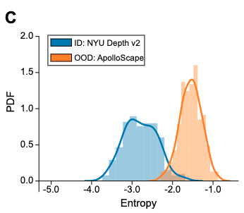
What Drives the Epistemic Variance?
As we have seen, increased regularization causes epistemic variance to increase
As hinted in the example of section 4.1 of Amini et al., Epistemic uncertainty (B) captures uncertainty on OOD data.
In our case, we could demonstrate this by removing sulfate from our test case, training the model on other species, then applying to the OOD sulfate data. This would be more easily done with the MODIS-AERONET set.
These would be extremely useful to screen out data for which our model is inadequate
Does the epistemic variance increase as we decrease the sample size?

